Slide 1
Figures
Note:
1. *THESE LABELLING ARE FROM checkpoint_v0.4. Up to 0.4.2, the heatmap result is the same.

Slide 2
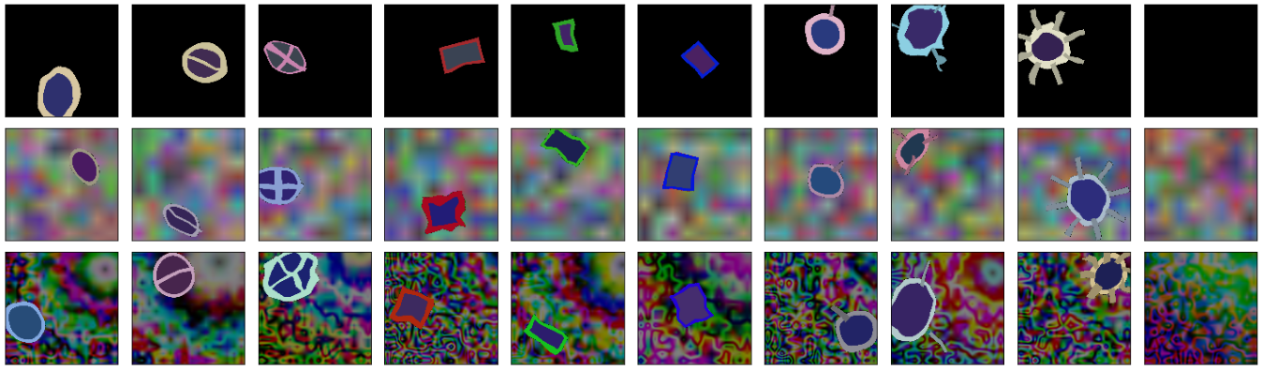
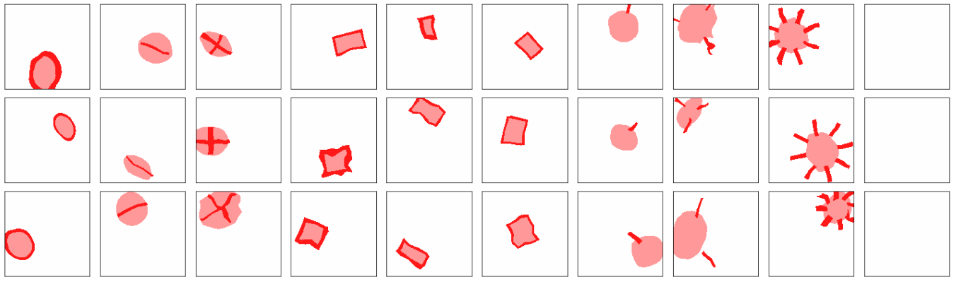

Slide 3
Part 1
Part 2
Part 3
Part 3.3
Part 1.2
Part 2.2
Part 3.2
Training
Mode: Continuous
Plot loss
Training
Mode: regular evaluation
Validation
On validation dataset
Selection
XAI Methods
Mode: Saliency etc
Testing
Accuracy on test dataset
Unpack XAI results
ROC AUC
DATA PREP
View Gallery

Slide 4
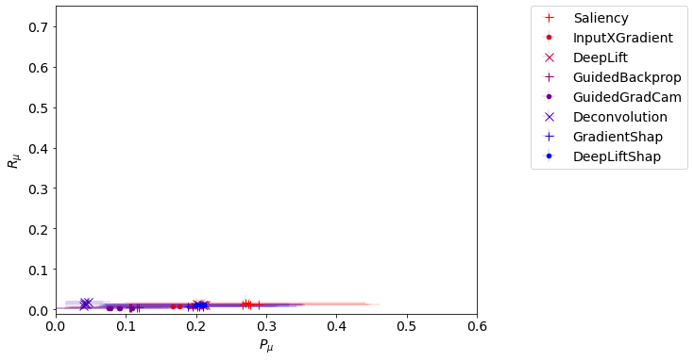
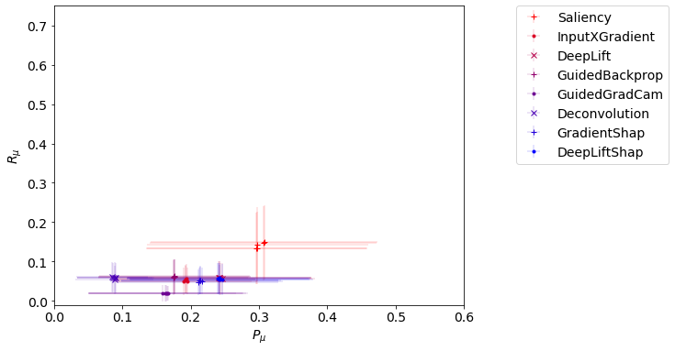
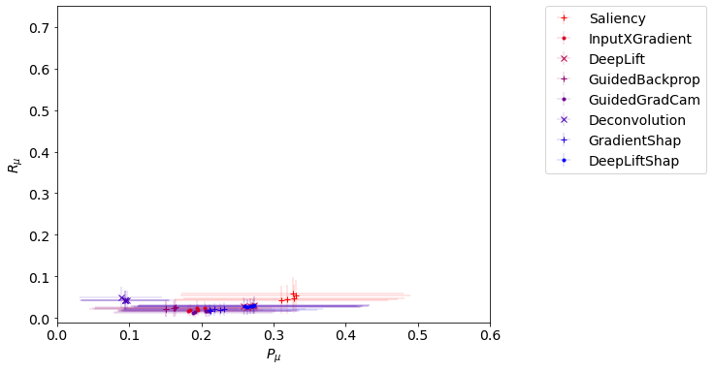
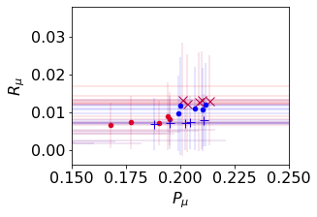
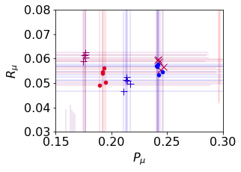
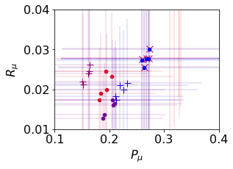
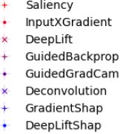
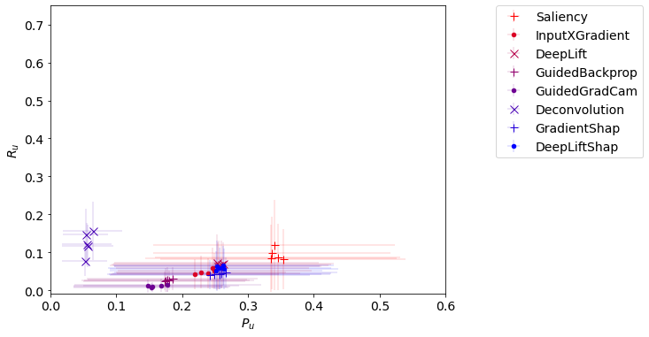
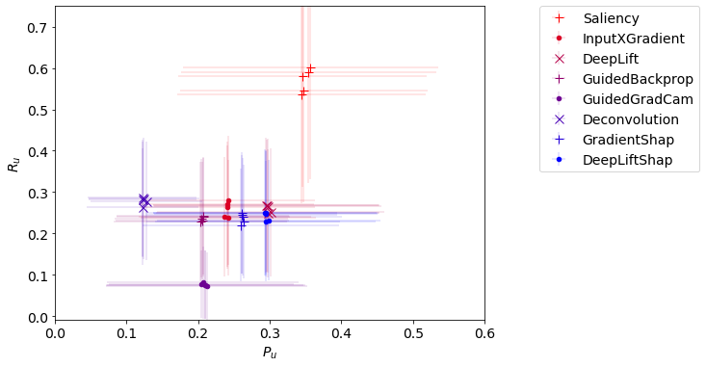
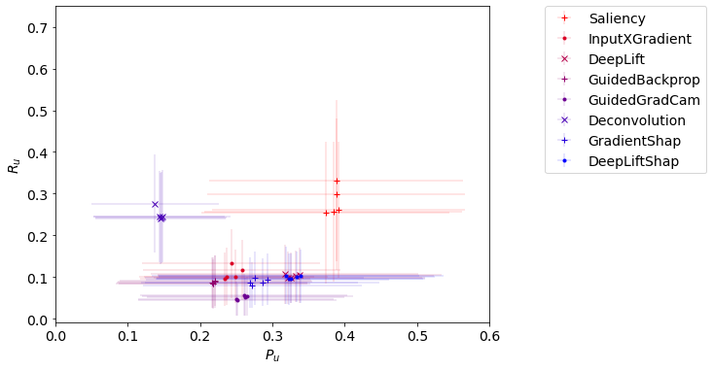
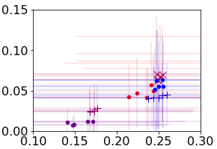

(A) Recall vs precision (Average)
ResNet
AlexNet
VGG
$$R$$
(B) Recall vs precision (Best)
ResNet
AlexNet
VGG
$$R$$

Slide 5
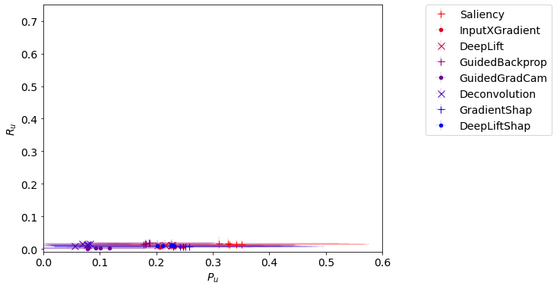
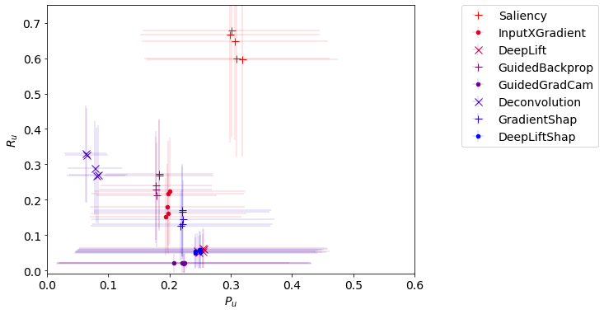
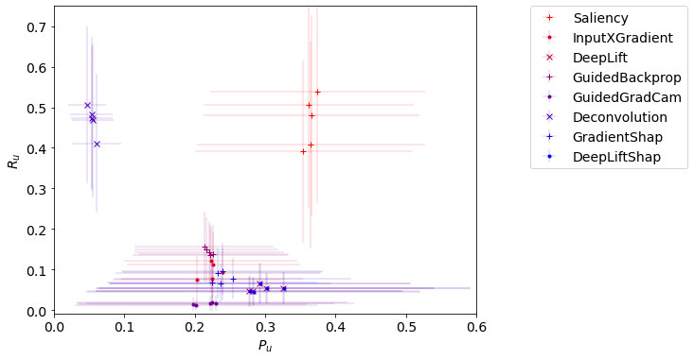
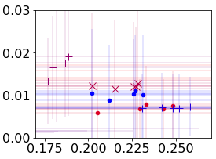

(C) Recall vs precision (Best, with clamp)
ResNet
AlexNet
VGG
$$R$$
$$P$$
$$P$$
$$P$$

Slide 6

(A) Recall vs precision (Average)
ResNet
AlexNet
VGG
$$R$$
0.6/0.0
0.6/0.0
(B) Recall vs precision (Best)
ResNet
AlexNet
VGG
$$R$$
0.6/0.0
0.6/0.0

Slide 7

(C) Recall vs precision (Best, with clamp)
ResNet
AlexNet
VGG
$$R$$
$$P$$
0.6/0.0
$$P$$
0.6/0.0
$$P$$

Slide 8
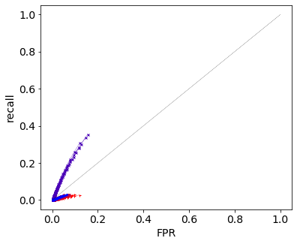
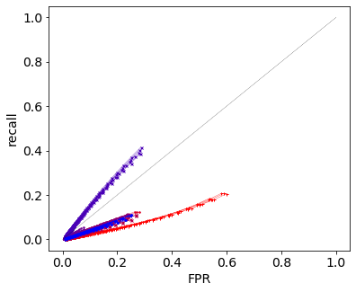
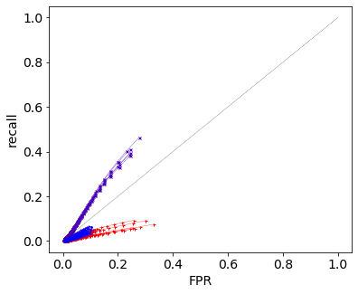
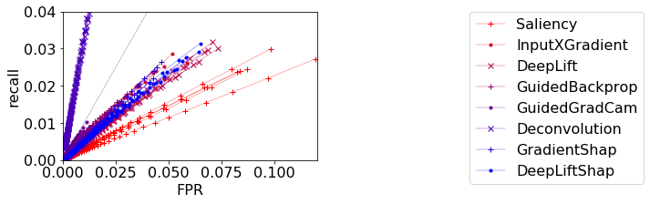
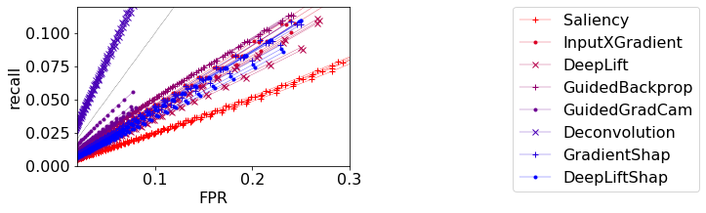
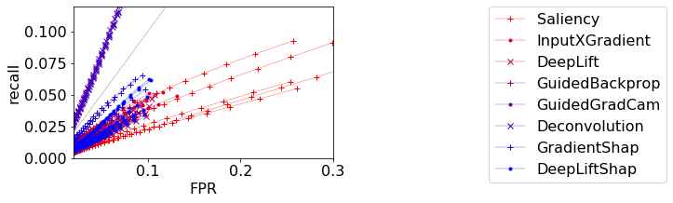
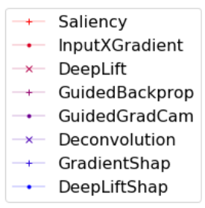

Slide 9
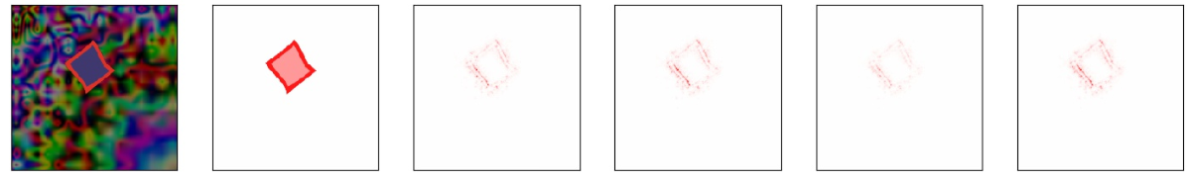
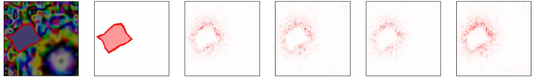
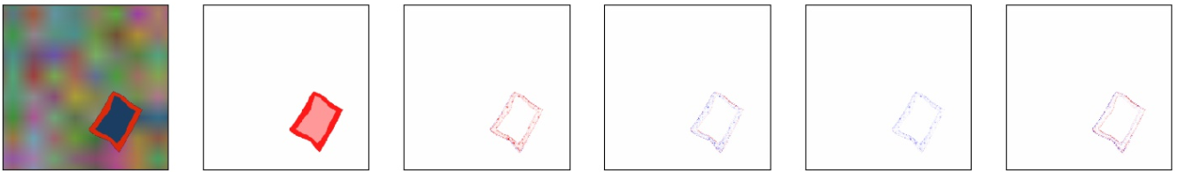
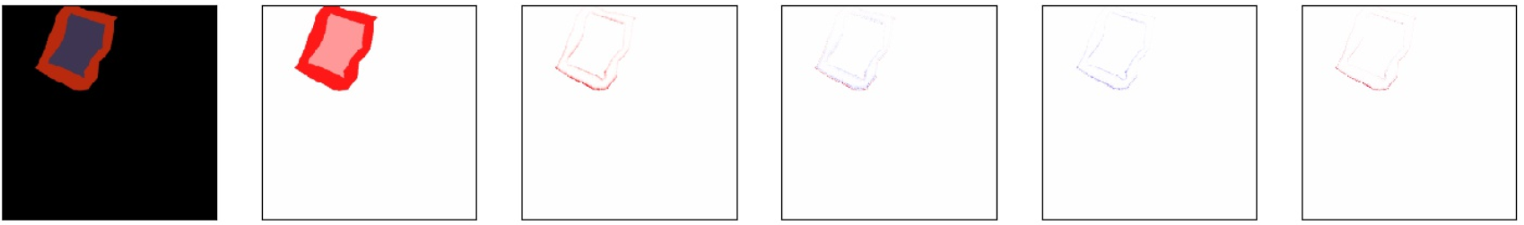
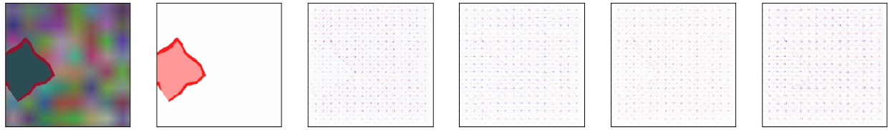
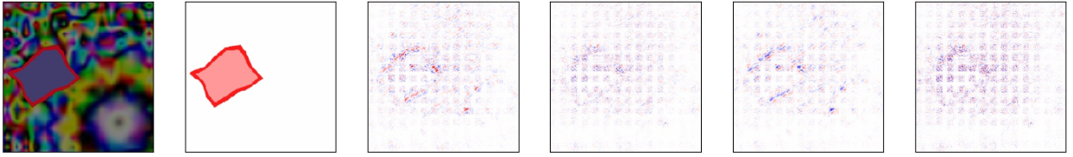
workflow1_0001.1\XAI_results\
gallery_workflow1_0001.1_Saliency.xai
workflow2_0001.1\XAI_results\
gallery_workflow2_0001.1_Saliency.xai
THESE LABELLING ARE FROM checkpoint_v0.4
workflow1_0001.1\XAI_results\
gallery_workflow1_0001.1_GuidedGradCam.xai
workflow3_0001.1\XAI_results\
gallery_workflow3_0001.1_GuidedGradCam.xai
workflow1_0001.3\XAI_results\
gallery_workflow1_0001.3_Deconvolution.xai
workflow2_0001.4\XAI_results\
gallery_workflow2_0001.4_Deconvolution.xai

Slide 10
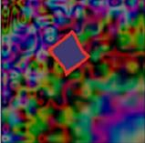

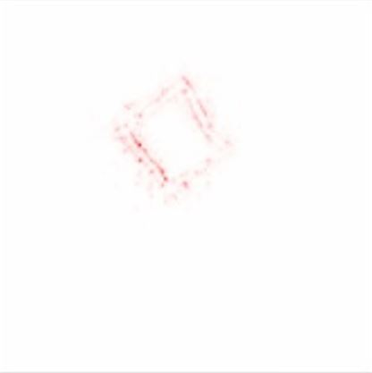
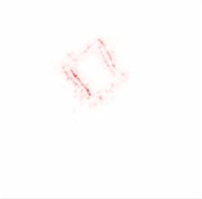
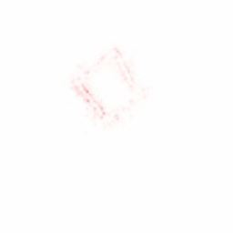
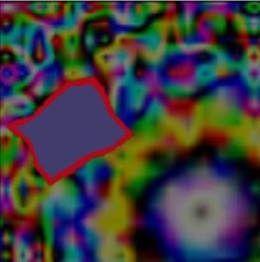
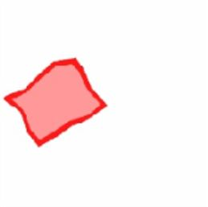
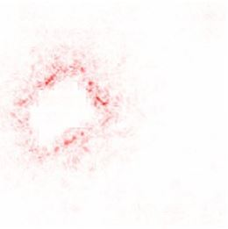
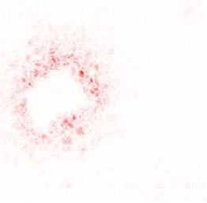
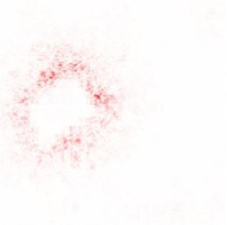
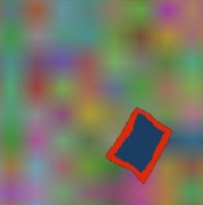

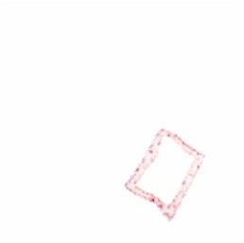
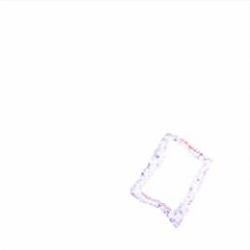
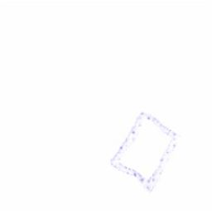


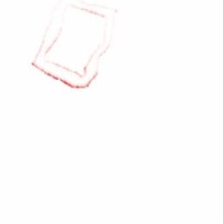
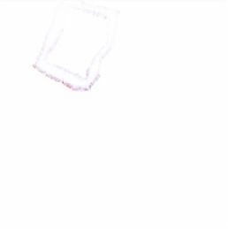
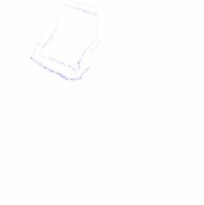

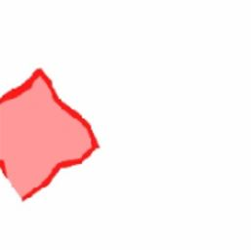
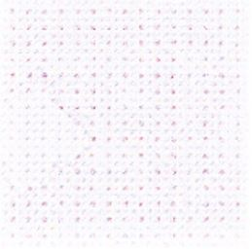
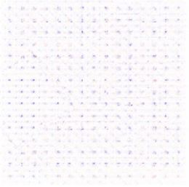
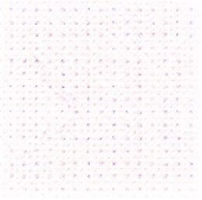






$$h_{0}$$
R
G
B
ResNet
Saliency
What can we say?
Saliency high scores may be obvious
GradCAM can be sensitive to color
Deconvolution high score is obvious
All figures are from correct prediction
AlexNet
ResNet
Guided GradCAM
Vgg
ResNet
Deconvolution
AlexNet

Slide 11











$h$ here is AFTER sum over channel
$$h$$
$$S_{t_{0}}^{5}(h)$$
$$S_{t_{55}}^{5}(h)$$
We can see some effects of soft thresholding
Deeplift higher precision, still low recall
DeepliftSHAP may score lower as seen in the main result, but visually inspecting the output, DeepLiftShap seems to remove the artifact
Compared to saliency, when it works (eg in Alexnet), the score difference seems to be the meaning of attribution of negative values
Observing the VGG examples, can see the quality is inconsistent
All figures are from correct prediction
(A)
DeepLift
workflow1_0001.1\XAI_results\
gallery_workflow1_0001.1_DeepLift.xai
DeepLiftShap
workflow1_0001.1\XAI_results\
gallery_workflow1_0001.1_DeepLiftShap.xai
Saliency
ResNet
workflow1_0001.1\XAI_results\
gallery_workflow1_0001.1_Saliency.xai
(B)
DeepLift
workflow2_0001.4\XAI_results\
gallery_workflow2_0001.4_DeepLift.xai
DeepLiftShap
workflow2_0001.4\XAI_results\
gallery_workflow2_0001.4_DeepLiftShap.xai
Saliency
workflow2_0001.4\XAI_results\
gallery_workflow2_0001.4_Saliency.xai
AlexNet
THESE LABELLING ARE FROM checkpoint_v0.4
(C)
DeepLift
workflow3_0001.4\XAI_results\
gallery_workflow3_0001.4_DeepLift.xai
DeepLift
Same as above
Vgg

Slide 12


Saliency
Input*Gradient

